Slide 1

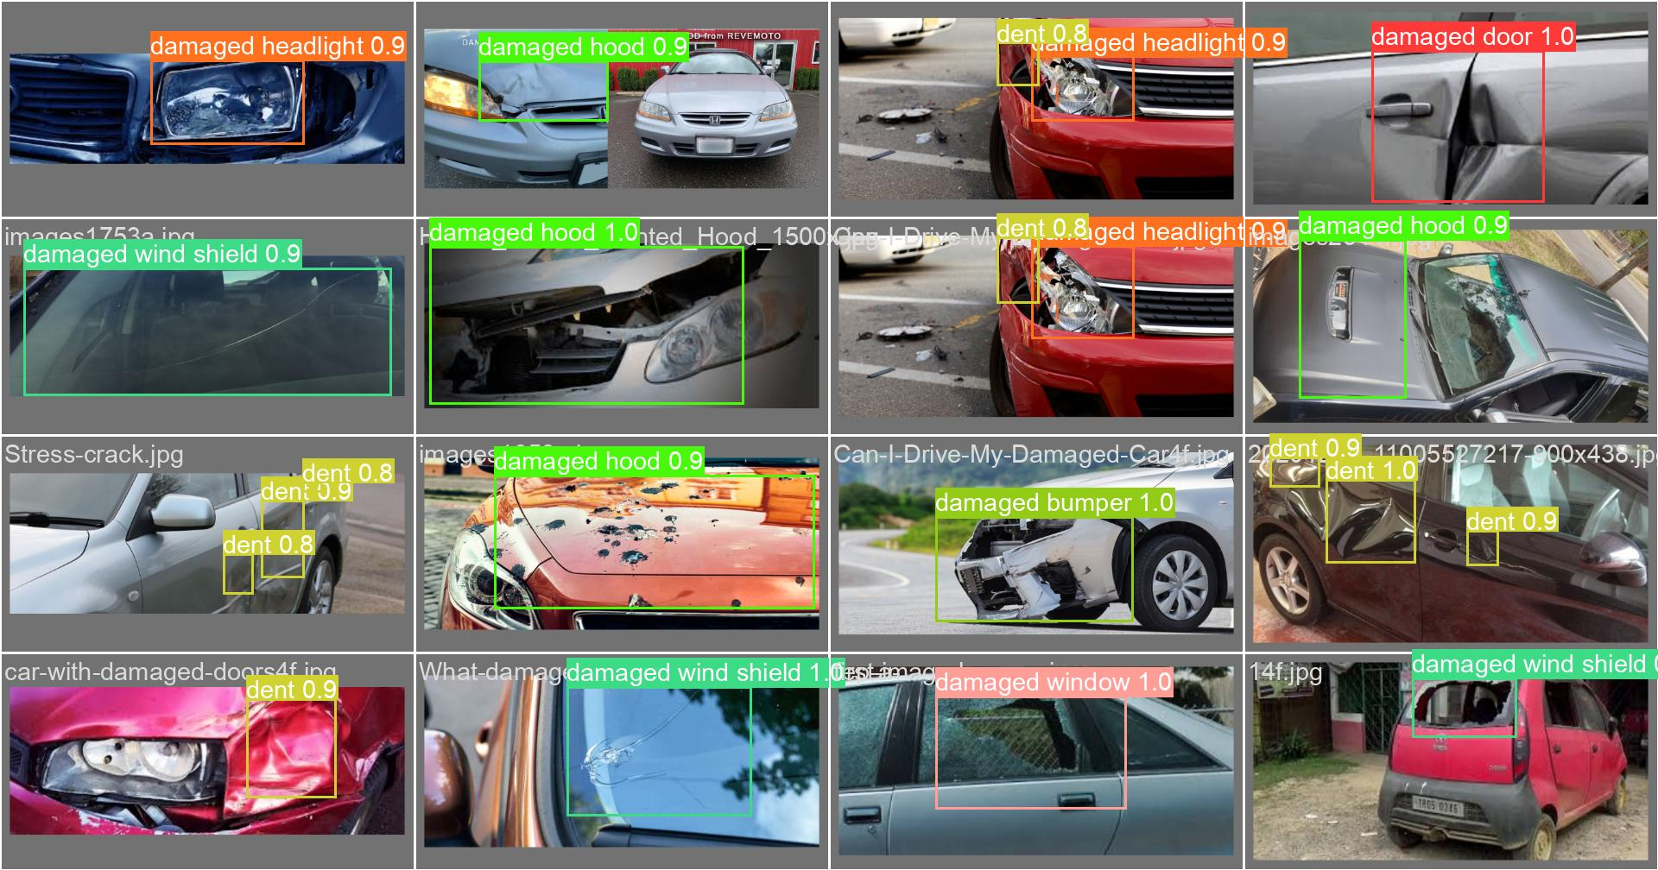
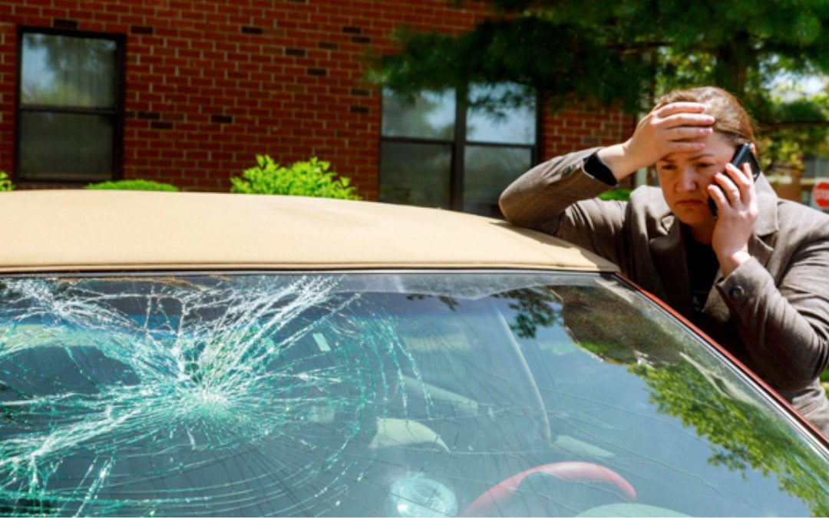
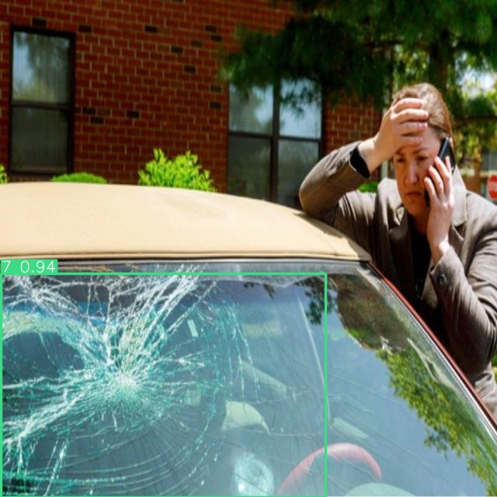
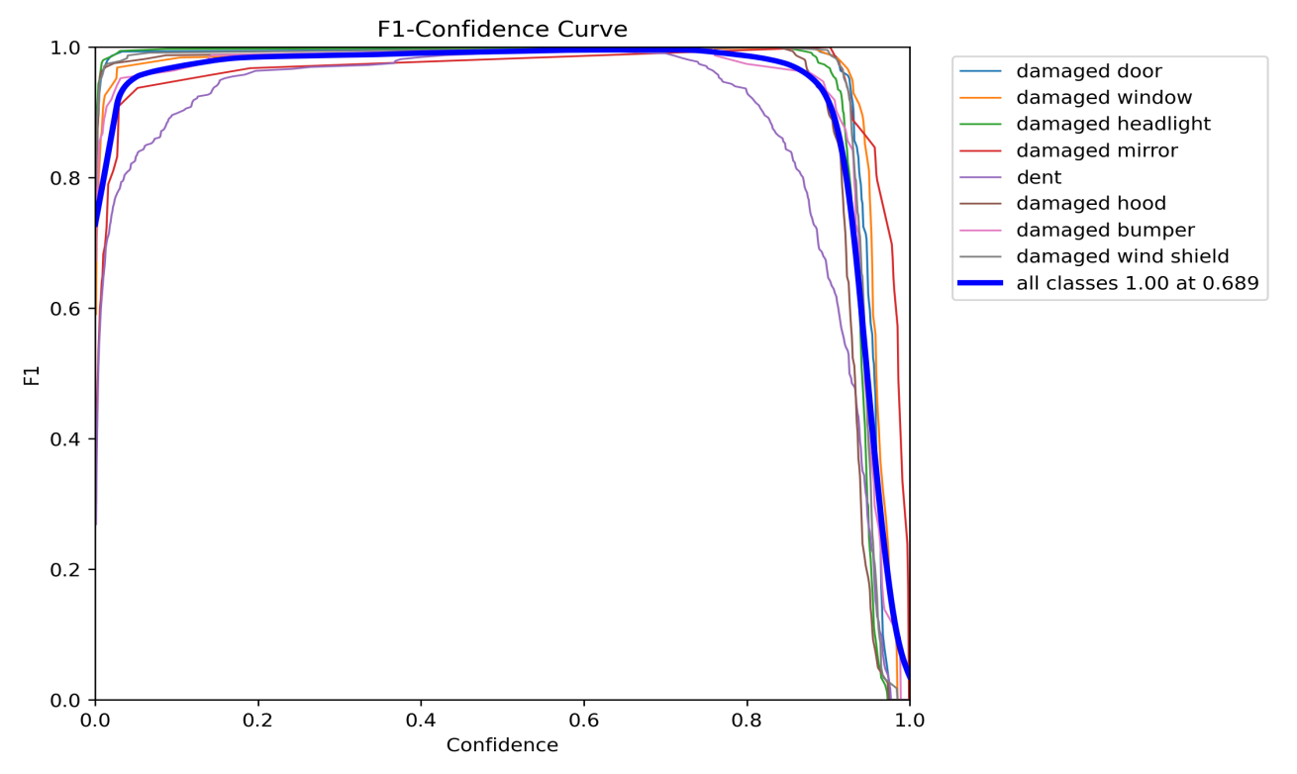
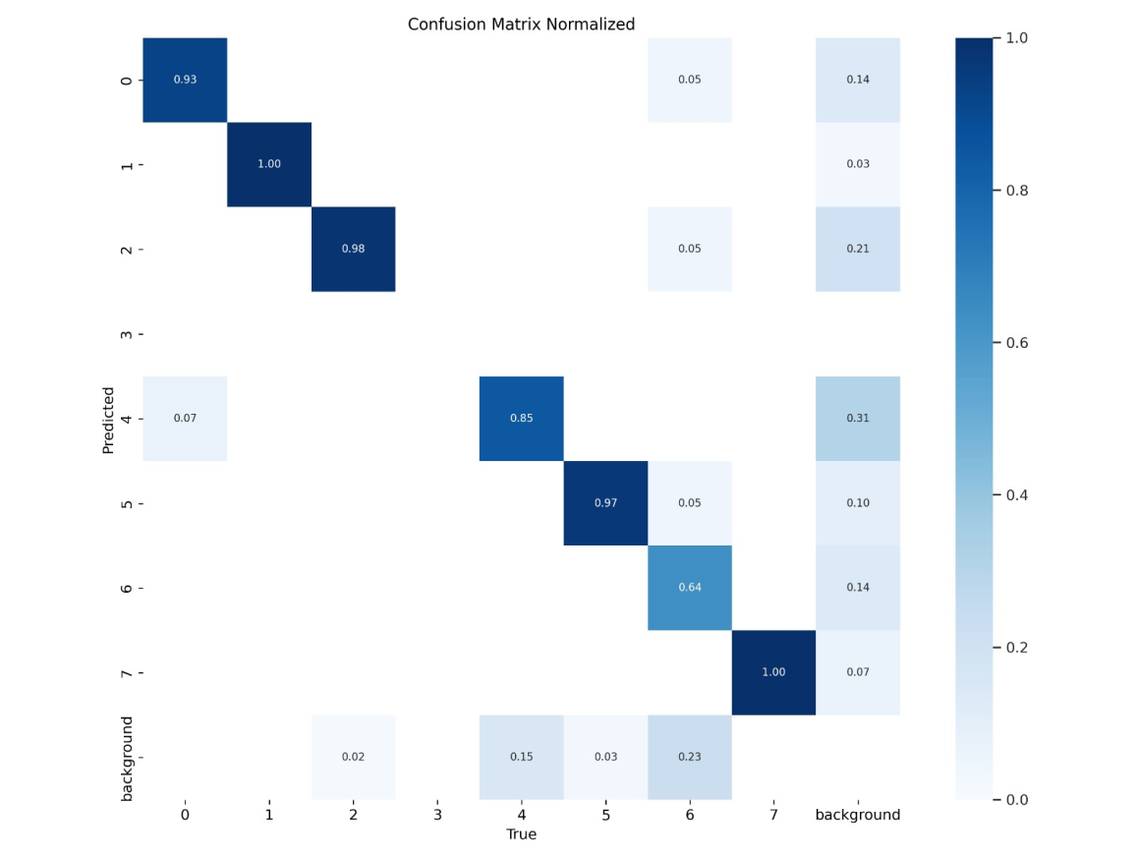
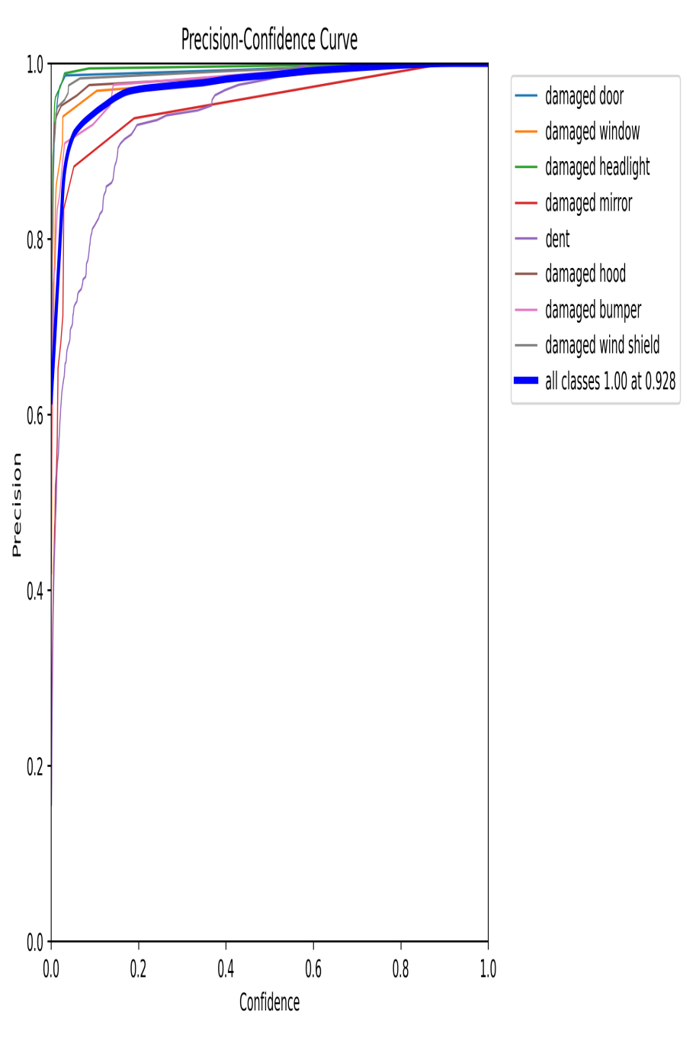
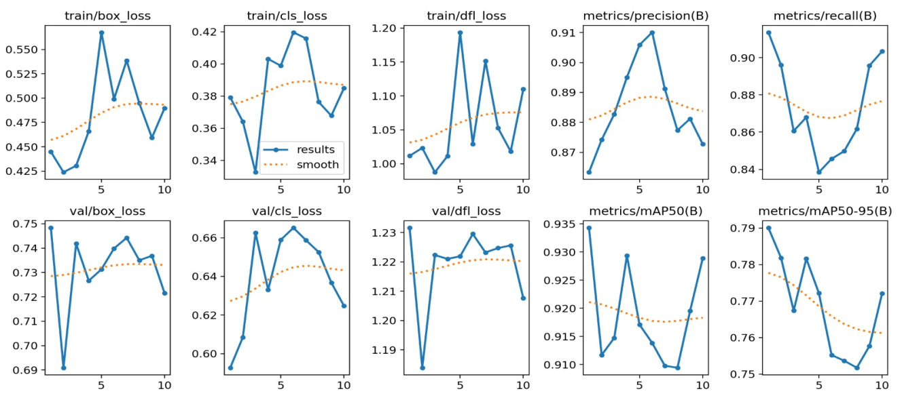
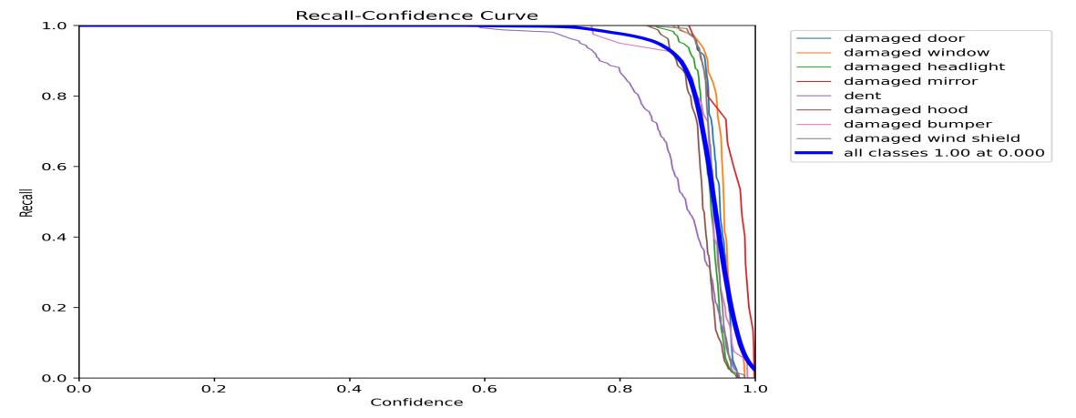
Car damage severity detection using YOLO-V8
Rida Jabbar
Data Science
Knowledge Streams
1. Motivation
2. Problem Statement
With a fervent drive to innovate insurance and automobile industries, this project implements deep learning and machine learning for automated car damage severity detection. The purpose:
• Eliminate manual inspection, streamlining processes.
• Enhance accuracy in damage assessment for fair claim settlements.
• Simplify claims for car owners with image or video documentation.
• Optimize manufacturing decisions based on detected damage severity.
In the realm of insurance and automotive industries, the manual inspection process for assessing car damage can be laborious and error-prone. It often leads to delays in claim settlements and inefficiencies in the manufacturing process.
Challenges :
Ensuring accuracy in detecting and assessing damage severity from images or videos.
Establishing robustness in data extraction to streamline processes and minimize errors.
Addressing complexities in implementing deep learning and machine learning algorithms for precise damage analysis.
3. Proposed Solution
4. Methodology
The proposed solution involves implementing the YOLOv8 model, trained on a dataset of 4000 car damage images, annotated using Roboflow. The dataset divided into 8 classes representing different levels of damage severity.
Frame Segmentation
Annotation
Object Detection
Vehicle Classification
Image
Preprocessing
Annotation
Detection
Deployment
5. Detection Results

